Slide 1

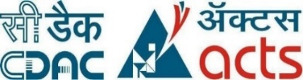
Implementation of DevSecops using Jenkins, Maven, SonarQube, Docker, Trivy and Docker Hub for web application deployment with vulnerability scanning
Submitted By : VAIBHAV CHAVAN (240344223038)
SUSHANT GHATOLKAR (240344223036)
UMESH PANCHAL (240344223023)
ANJALI BAIS (240344223002)

Slide 2

Under the guidance of Mr. Sandeep Walvekar In partial fulfillment of the award of Post Graduate Diploma in IT Infrastructure, Systems and Security (PG-DITISS) Sunbeam Institute of Information Technology, Pune (Maharashtra) PG-DITISS -2024

Slide 3
Introduction :
This project uses a DevSecOps framework to automate and secure the deployment of a Java-based web application. It integrates security practices throughout the development lifecycle, emphasizing seamless integration of DevOps , Security and operations.
A suite of tools, including GitHub, Jenkins, Maven, SonarQube, OWASP , Docker and Docker Hub, Trivy and Docker hub are used to ensure optimal operation and security.

Slide 4
1. Jenkins will fetch the code from the remote repo 2. Maven will build the code, if the build fails, the whole pipeline will become a failure and Jenkins will notify the user, If build success then 3. Junit will do unit testing, if the application passes test cases then will go to the next step otherwise the whole pipeline will become a failure Jenkins will notify the user that your build fails. 4.SonarQube scanner will scan the code and will send the report to the SonarQube server. In the quality gate, we define conditions or rules like how many bugs or vulnerabilities, or code smells should be present in the code. Also, we have to create a webhook to send the status of quality gate status to Jenkins. If the quality gate status becomes a failure, the whole pipeline will become a failure then Jenkins will notify the user that your build fails. After the quality gate passes, Docker will build the docker image. if the docker build fails when the whole pipeline will become a failure and Jenkins will notify the user that your build fails.
Pipeline flow :

Slide 5
4. After the quality analysis, Docker will build the docker image. if the docker build fails when the whole pipeline will become a failure and Jenkins will notify the user that your build fails. 5. Trivy will scan the docker image, if it finds any Vulnerability then the whole pipeline will become a failure, and the generated report will be sent to s3 for future review and Jenkins will notify the user that your build fails. 6.After trivy scan docker images will be pushed to the docker hub, if the docker fails to push docker images to the docker hub then the pipeline will become a failure and Jenkins will notify the user that your build fails. 7.After the docker push, Jenkins will create deployment and application will be deployed into Docker Hub. if Jenkins fails to create deployment and service in Kubernetes, the whole pipeline will become a failure and Jenkins will notify the user that your build fails.

Slide 6
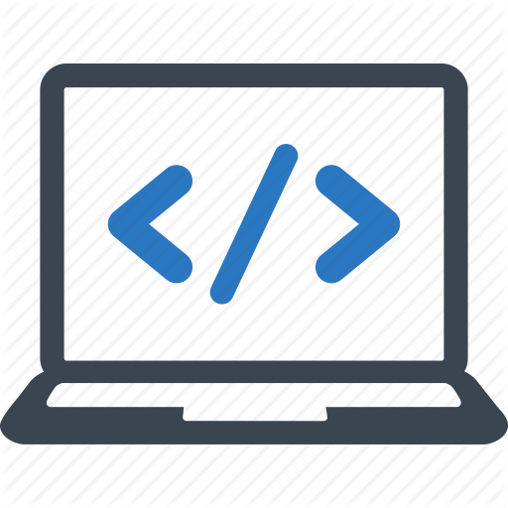


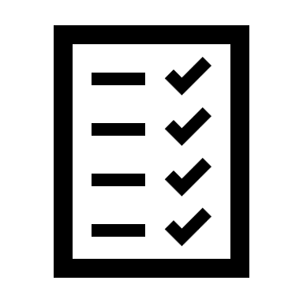
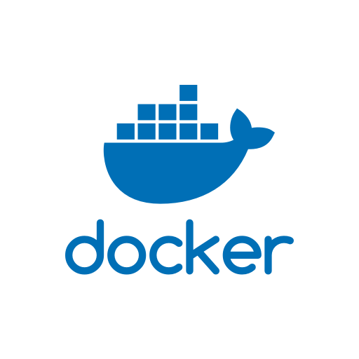
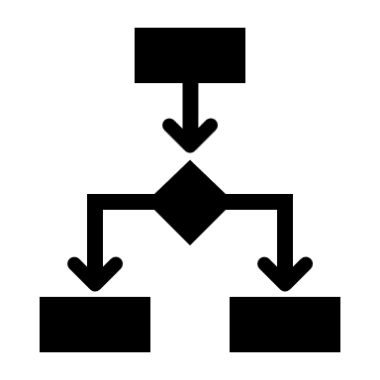
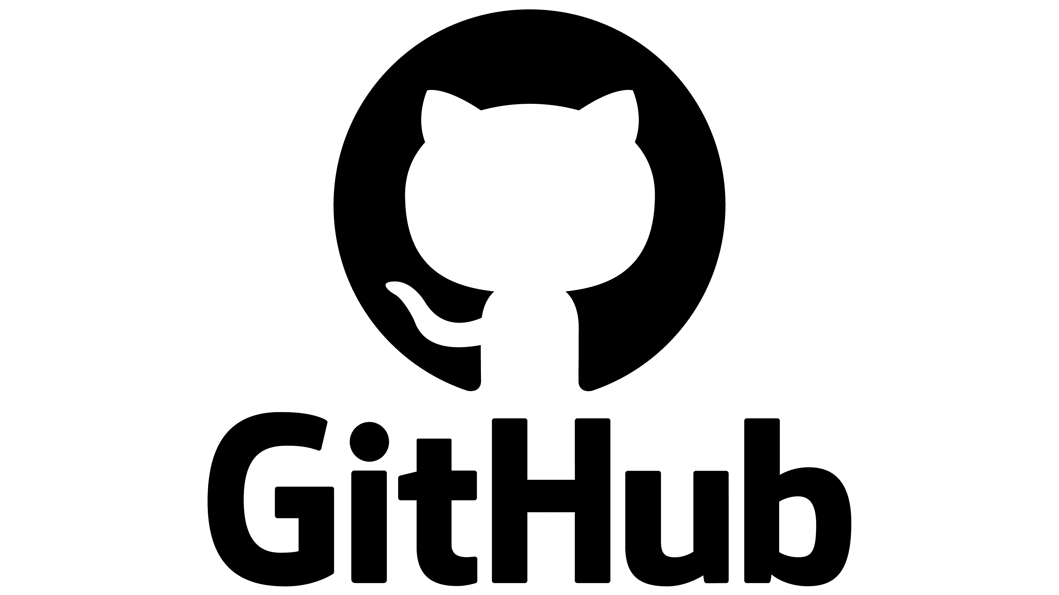
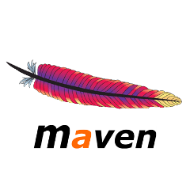
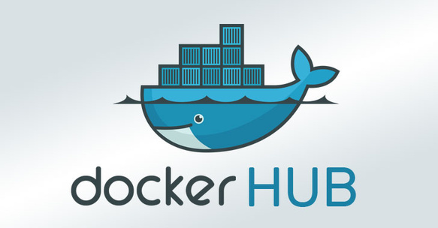

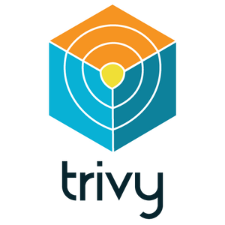
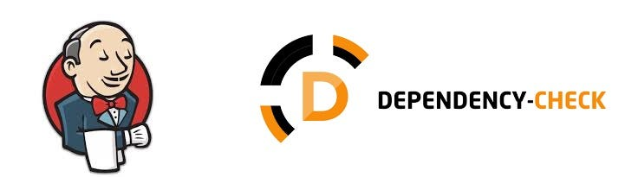
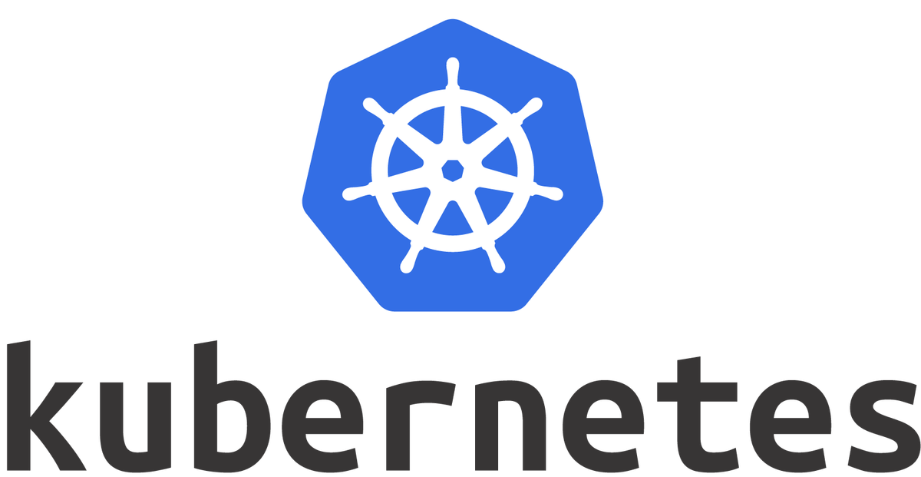
PROJECT ARCHITECTURE :

Slide 7
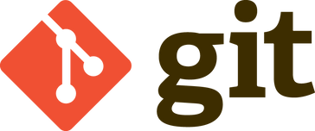
Git :- Git is a distributed version control system (VCS) designed to manage source code history and facilitate collaborative software development.
Jenkins :- Jenkins is an open-source automation server that facilitates the continuous integration and continuous delivery (CI/CD) of software projects. It helps automate various tasks related to building, testing, and deploying applications, making the development and release process more efficient and reliable.

Slide 8
Maven :- Maven is a powerful project management and comprehension tool that provides developers with a complete build lifecycle framework. Using an XML file to describe the project structure, dependencies, build order, and required plugins, Maven automates the build process and manages project dependencies from a central repository. This simplifies the work of developers by handling project building, reporting, and documentation from a central piece of information.
SonarQube :- SonarQube is an open-source platform designed for continuous inspection of code quality. It performs automatic reviews with static analysis of code to detect bugs, code smells, and security vulnerabilities in over 20 programming languages. SonarQube integrates with CI/CD workflows to provide developers with immediate feedback on code quality issues and improvement suggestions, facilitating better codebase maintainability and reducing the risk of vulnerabilities.

Slide 9
Docker :- Docker is an open-source platform that allows you to automate the deployment, scaling, and management of applications using containerization. Containers are lightweight, portable, and isolated environments that package an application and its dependencies together.
Docker Hub :- Docker Hub is a cloud-based registry service provided by Docker that allows users to store and share Docker container images. It serves as a central repository for Docker images, making it easy for developers to distribute and deploy applications in containerized environments

Slide 10
Trivy :- Trivy is a comprehensive, open-source vulnerability scanner that specializes in detecting security vulnerabilities within container images, file systems, and Git repositories. Trivy scans for vulnerabilities in OS packages (Alpine, RHEL, CentOS, etc.) and application dependencies (Bundler, Composer, npm, yarn, etc.), providing detailed reports to help developers identify and fix security issues efficiently
OWASP :- OWASP Dependency-Check is a tool developed by the Open Web Application Security Project (OWASP) that is used to identify vulnerabilities in third-party libraries and dependencies that your application uses. It is particularly useful in modern software development where applications often rely on open-source components, libraries, and frameworks..

Slide 11
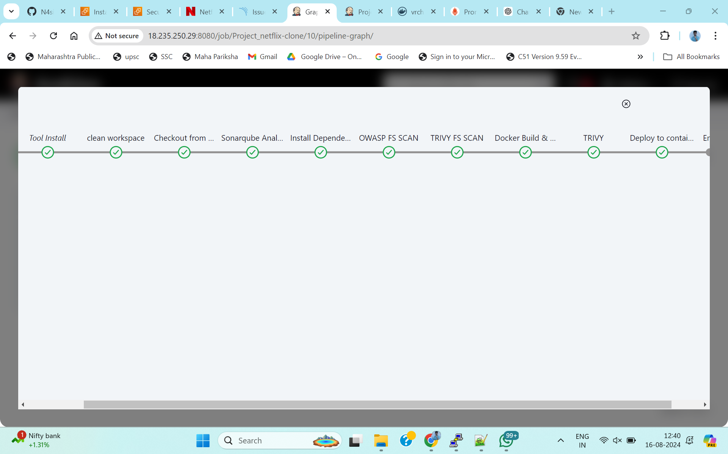
Jenkins:

Slide 12
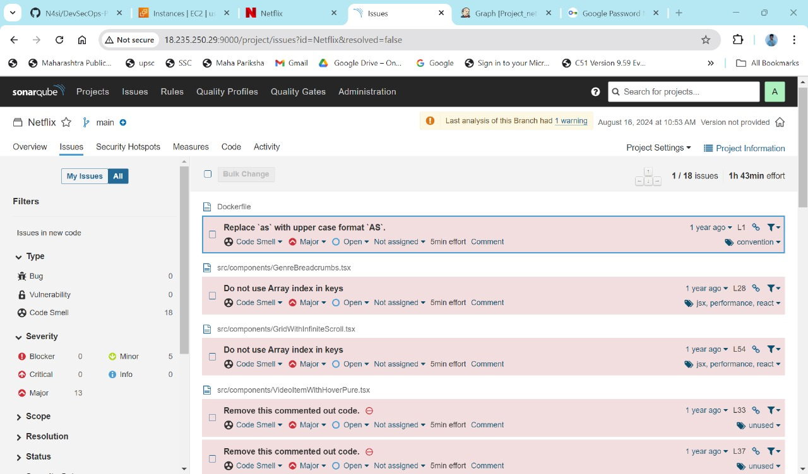
SonarQube :

Slide 13
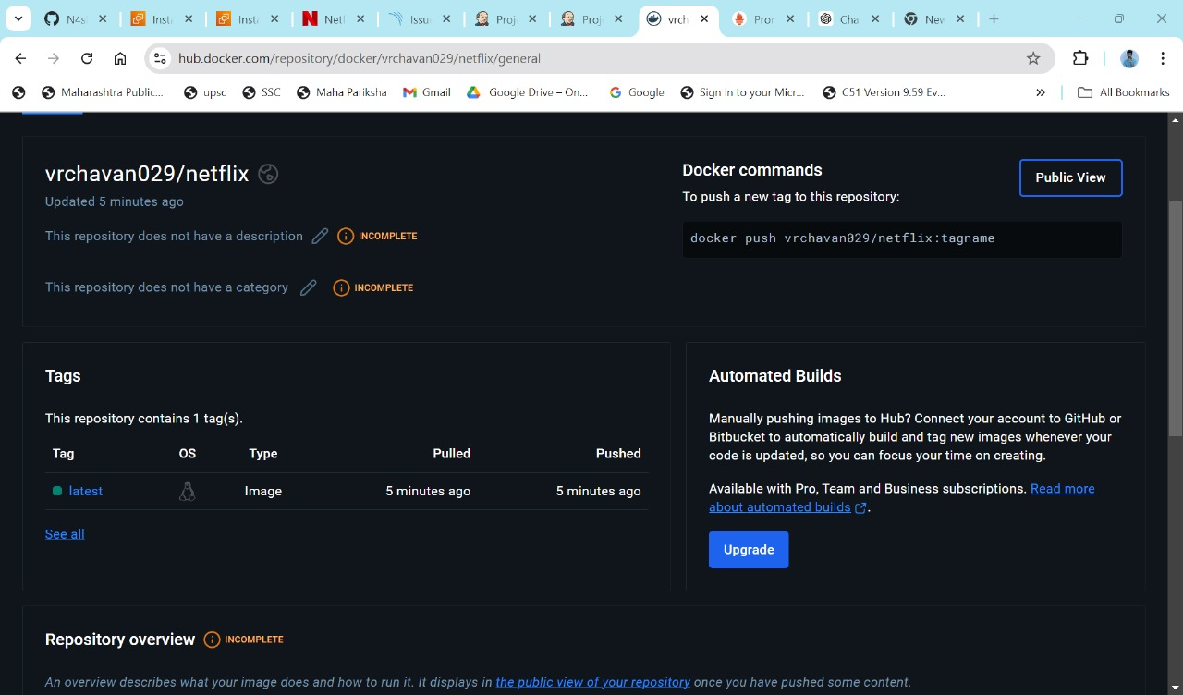
Docker Hub:

Slide 14
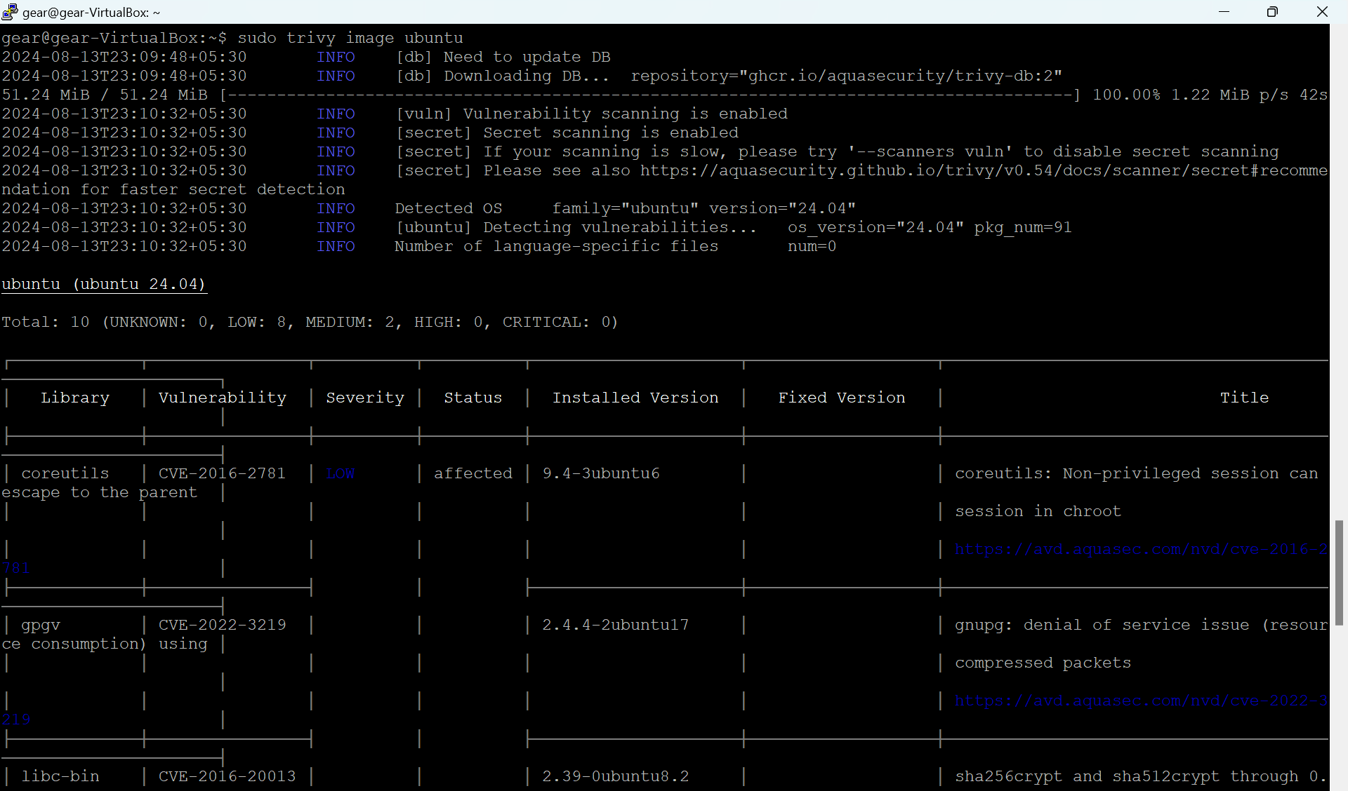
Trivy :

Slide 15
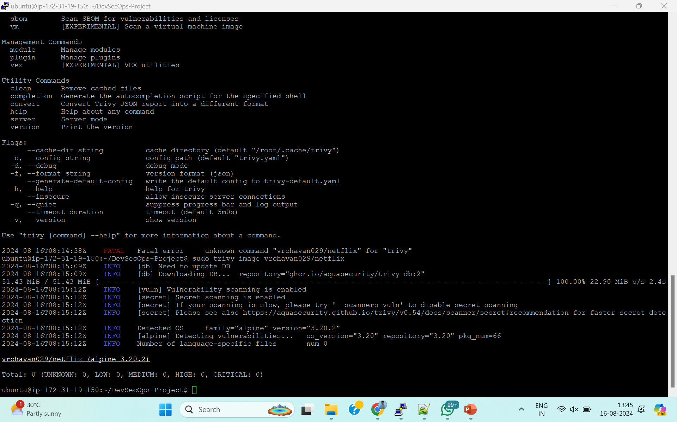

Slide 16
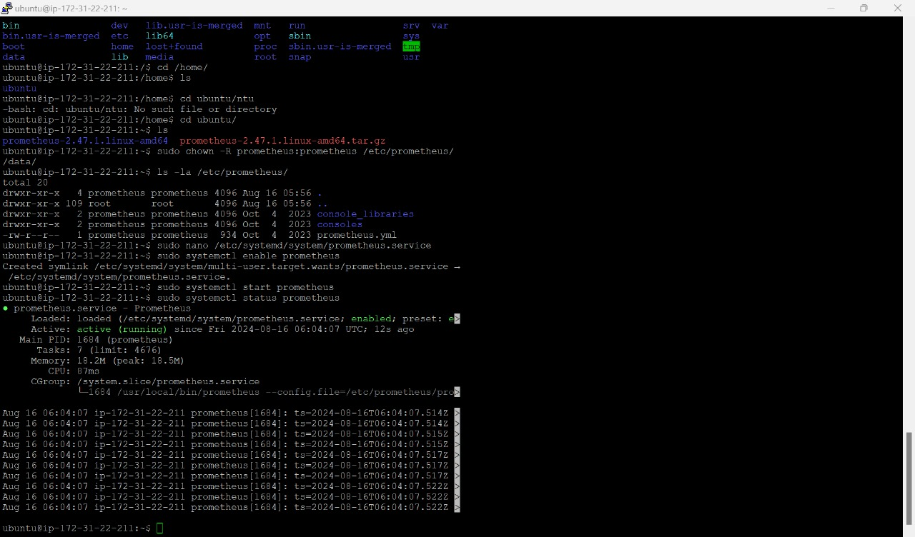
Prometheus :

Slide 17
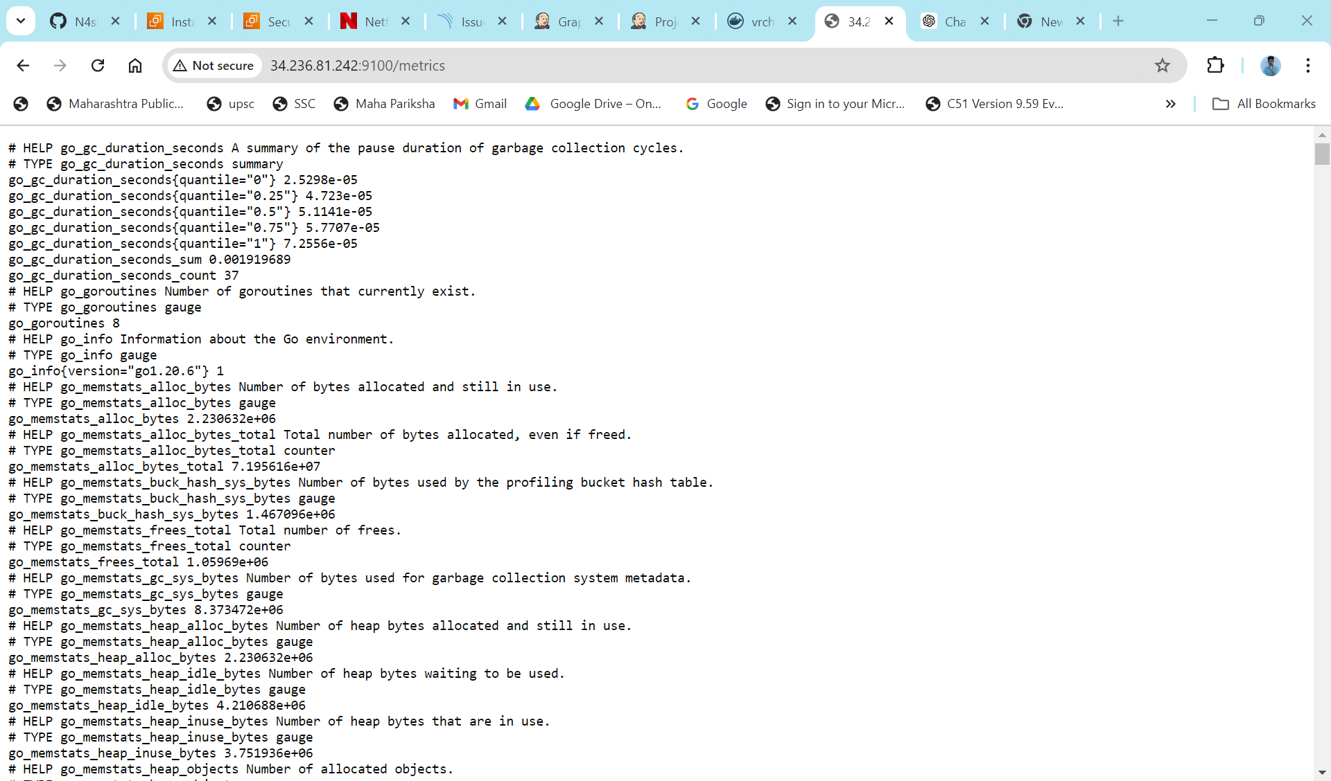

Slide 18
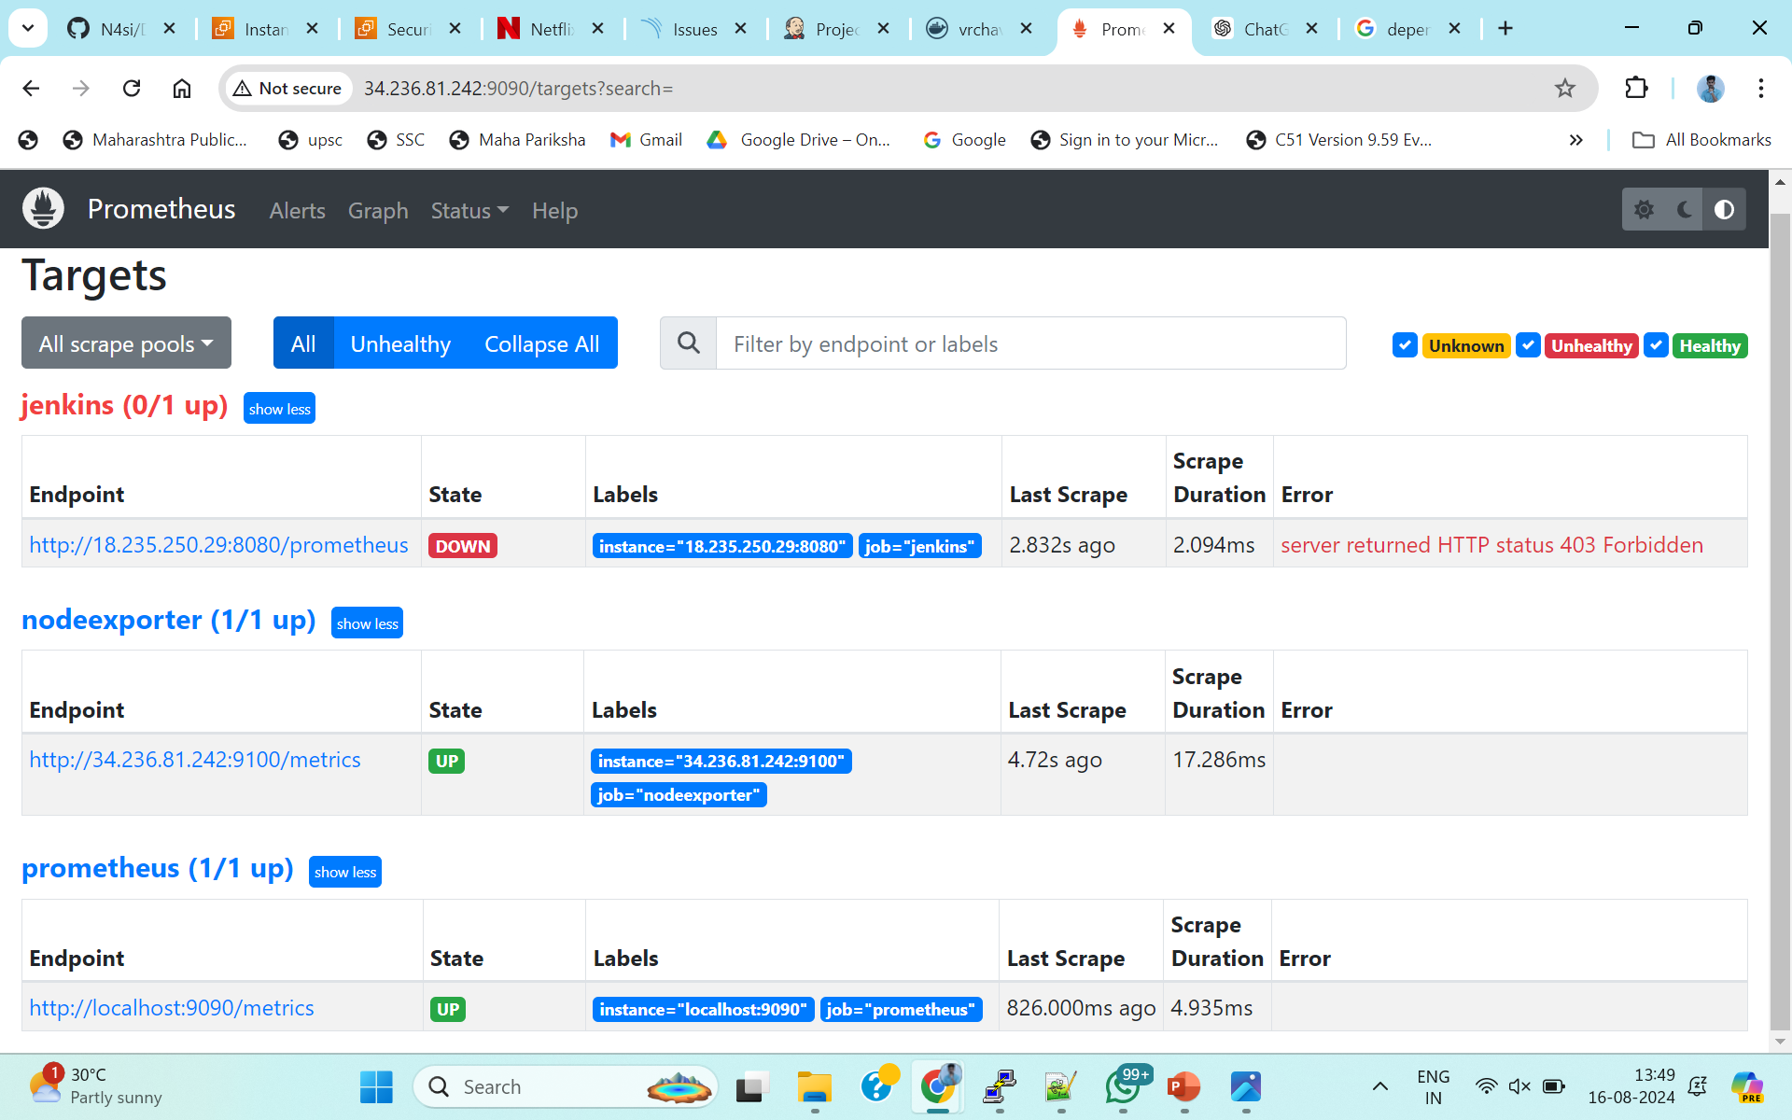

Slide 19
Conclusion:
Project Implementation: DevSecOps Framework for Web Application. Successfully automated and secured deployment of a Java-based web application.
Utilized tools like GitHub, Jenkins, Maven, OWASP, SonarQube, Docker, Trivy and Docker Hub.
Established robust, secure, and efficient lifecycle management system. Enhanced operational performance and exemplified DevSecOps principles in software development.

Slide 20
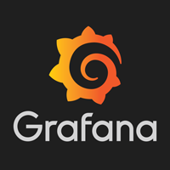
Future Scope :
Kubernetes:- Kubernetes is an open-source container orchestration platform designed to automate deploying, scaling, and operating application containers. It groups containers that make up an application into logical units for easy management and discovery.
Grafana :- Grafana is an open source tool which is used for monitoring and visualization of data from different sources in real time. It is mainly used for developing real-time and active application dashboards that would help to monitor the health and performance of the applications, infrastructure as well as the services being offered.

Slide 21
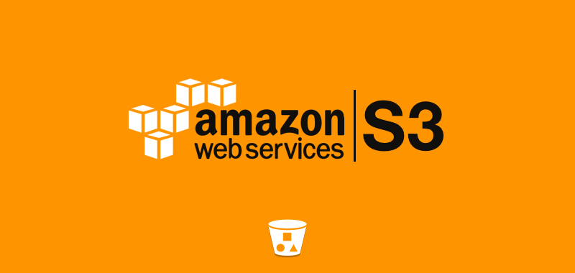
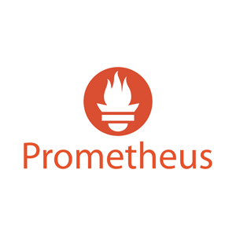
Amazon Simple Storage Service (AWS S3) :-
Amazon Simple Storage Service (AWS S3) is a scalable, durable, and highly available object storage service offered by Amazon Web Services (AWS). S3 is designed to store and retrieve any amount of data from anywhere on the web, making it a fundamental building block for cloud-based applications.
OWASP Dependency-Check is a tool developed by the Open Web Application Security Project (OWASP) that is used to identify vulnerabilities in third-party libraries and dependencies that your application uses. It is particularly useful in modern software development where applications often rely on open-source components, libraries, and frameworks.

Slide 22
THANK YOU !

